Slide 1
Texting and Driving
Austin Wagoner and Jason Vaughn
Notes:
Introduction
Did you know…
Who likes to text?
Who likes to drive?
Who texts and drives? (How many?)
This upcoming video is for you.
Did you know that texting and driving is almost equivalent to drinking and driving?
Watch this video…

Slide 2
Notes:
Watch this video…

Slide 3
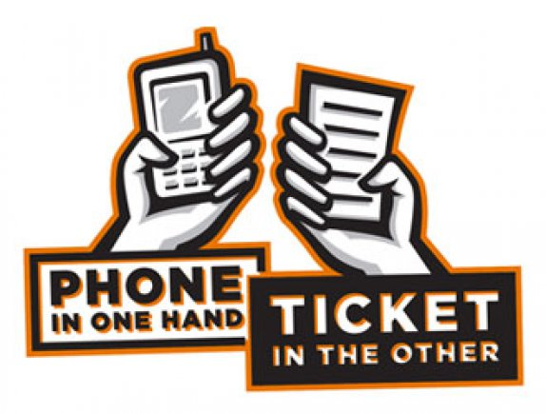
Purpose
Our purpose is to:
Educate our senior class about the dangers of texting and driving
Severe injury
Death
Inform people of the possible consequences of texting while driving
Ticket and loss of license
Punishment
Notes:
Our purpose is to educate and advise seniors about the dangers of texting and driving
Our purpose is to inform people of the possible consequences of texting while driving

Slide 4
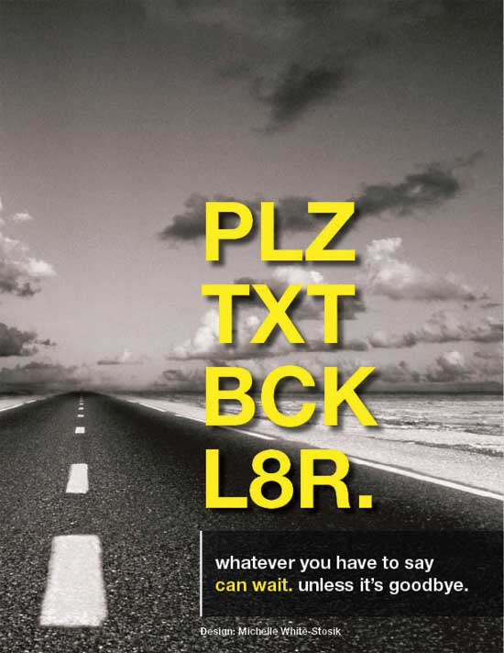
What is texting and driving?
Texting and driving is:
texting while operating a motor vehicle
a hazard to other drivers and pedestrians
one of many distractions in the car
Notes:
Texting and driving is
Texting while operating a motor vehicle
A hazard to other drivers and pedestrians
One of many distractions in the car

Slide 5
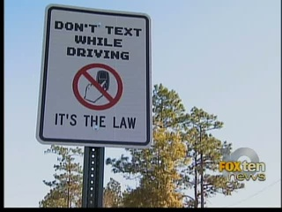
Problem
46% of teens text and drive (AAA, 2007)
Teenagers are the worst offenders
52% of parents do not punish their teenagers who text and drive (SADD)
Only 36% of teenagers are punished (SADD)
Notes:
Austin: 46%...
Jason: 52%...

Slide 6
Statistics
Texting and other distracted driving account for nearly 80% of all automobile accidents (Atlanta Injury Attorneys, 2012).
37% of drivers have sent or received text messages while driving (HealthDay, 2011).
6,000 deaths and a half a million injuries are caused by distracted driving each year (HealthDay, 2011).
Notes:
Austin: Texting while driving account for 80% of crashes
Jason: 37% admit to sending text messages when driving
Austin: 6000 deaths and 500,000 injuries are caused by distracted driving

Slide 7
Solutions
Text OR Drive; not both
Install applications on your phone that tell your friends you are driving
ShoutOut
On the Move
Sprint Drive First App
DriveMode
Notes:
Text OR Drive; not both
Install applications on your phone that tell your friends you are driving
ShoutOut
On the Move
Sprint Drive First App
DriveMode
If someone texts you while driving, these will reply automatically

Slide 8
Lol!
Where are you?
Can’t talk. Driving.
I’m on the way.
Notes:
Are these words worth your life?

Slide 9
Bibliography
“Teen Driver Menace: Text-Messaging.” suite101.com. Suite101, n.d. Web. 21 Jan. 2012.
http://steve-vogel.suite101.com/teen-driver-menace-textmessaging-a33901
“Cell Phone & Texting Accident Statistics.” edgarsnyder.com. Edgar Snyder & Associates®, n.d. Web. 21 Jan. 2012.
http://edgarsnyder.com/car-accident/cell-phone/statistics.html
Notes:
We have cited our sources
If you would like a copy of our presentation, we would be more than happy to email it to you
Thank you for your time and attention!

Slide 10
Bibliography Continued
“Georgia Motor Vehicle Accidents – Texting While Driving Increases Risk of Serious Injury or Death.” atlantainjuryattorneysblog.com. Atlanta Injury Attorneys. 10 Feb. 2010. Web. 21 Jan. 2012.
http://www.atlantainjuryattorneysblog.com/2010/02/texting-while-driving-increase.html
MNDPS. “Teen Body Bag” Minnesota Texting While Driving TV Spot. YouTube, 2011. MP4.
http://www.youtube.com/watch?v=6Kvqw0ExM7k

